Slide 1

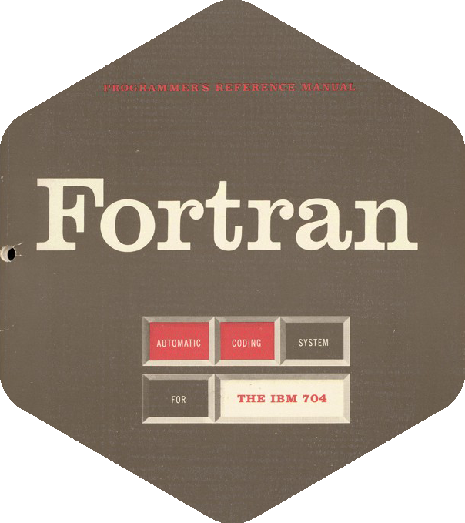




Tinker
GROMOS
Amber

Slide 2
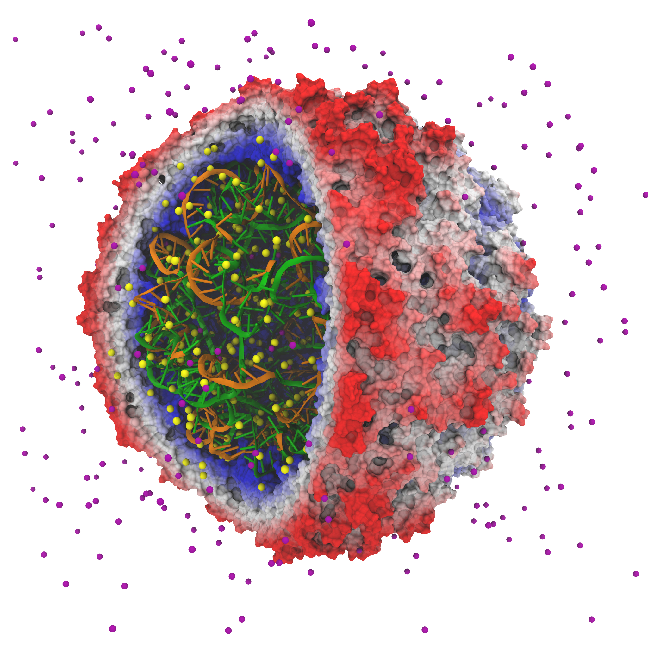
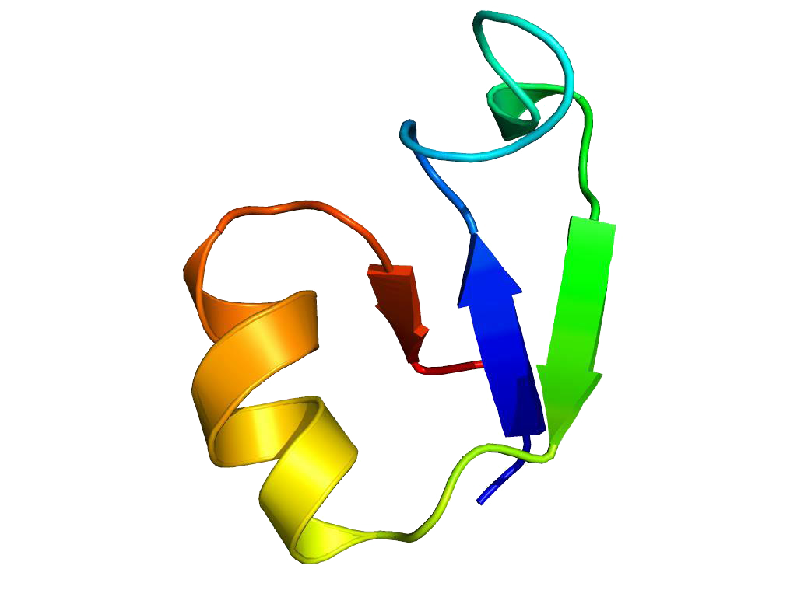
I took a number of rubber balls and stuck them together with rods of a selection of different lengths ranging from 2.75 to 4 inches. I tried to do this in the first place as casually as possible, working in my own office, being interrupted every five minutes or so and not remembering what I had done before the interruption.
John Desmond Bernal, 1962
Introduction of Anton supercomputer
First simulation of a folding process
First simulations of hard spheres
First simulation of a biological process
Simulation of full satellite tobacco mosaic virus.
1 million atoms for 50 ns
Simulation of NTL9
1.112 ms

